Slide 1

ACM Database Refresh strategy at University of Florida Health Discuss Fluid capabilities and bolt-on customizations
SESSION 19067
June 19th 2019

Slide 2
presenters
Deepak Vij
David Miller
Associate Director – ERP Systems
UF Health
vijdee@Shands.ufl.edu
System Administrator
UF Health
miller.david@shands.ufl.edu

Slide 3

Agenda
Overview
UF Health Overview
ERP Overview
Why ACM?
ACM overview
App Designer
Online ACM
Downloading and editing template files
Running through command line
Pre-boot vs Post-boot
Encrypting sensitive data
Executing and verifying a template file
The “Hidden” ACM code
Adding code to the App Package.
Creating a template online
Troubleshooting using PIA tools
Q&A

Slide 4
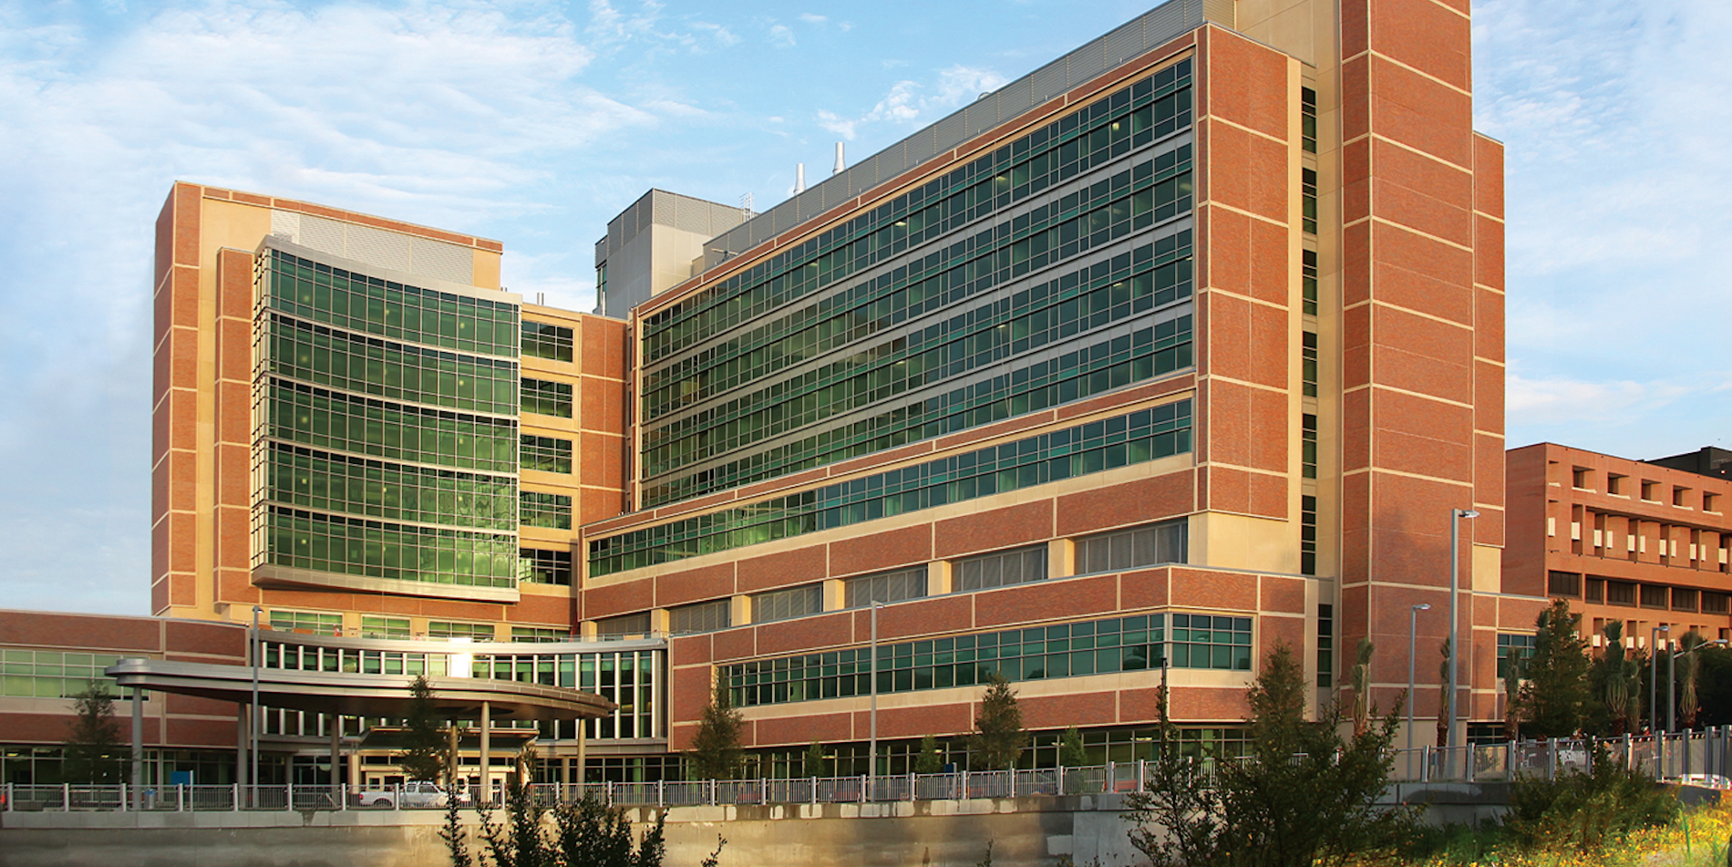
UF Health Overview
$3.42 Billion operation under the governance of the University of Florida
2 Campuses
6 Health Colleges
2 Teaching Hospitals
9 Research Centers & Institutes

Slide 5

UF Health Facts
UF Health is a ‘not-for-profit’, integrated health system offering patients a continuum of coordinated, high quality care
Established 1958 - Academic Health Science Teaching Hospital with University of Florida
Based in Northeast Florida in Gainesville and Jacksonville Locations
UF Health Shands Hospital (Gainesville)
UF Health Jacksonville (Jacksonville)
UF Health Shands Rehab Hospital (Gainesville)
UF Health Shands Psychiatric Hospital (Gainesville)
UF Health Shands Rehab Centers (Gainesville)
UF Health Shands HomeCare and Shands Jacksonville Home Health (Gainesville and Jacksonville)
UF Health Physicians (Gainesville and Jacksonville)
Shands also owns a minority interest in three rural community hospitals in Lake City, Live Oak and Starke through a joint venture with Health Management Associates
Shands Lake Shore Regional Medical Center
Shands Live Oak Regional Medical Center
Shands Starke Regional Medical Center
And growing as we speak…..

Slide 6

Our Core Values
At UF Health, our core institutional values are centered around our commitment to our patients and our role in the communities we serve:
Accountability
Collaboration
Compassion
Competence
Communication
Creativity
Empowerment
Excellence
Integrity
Respect
Trust

Slide 7

UF Health & ORACLE
Peoplesoft Innovator Award 2017 & 2019
HCM Version 9.2 / 8.55 PUM 23
FSCM Version 9.2 / 8.56 PUM 25

Slide 8
Active HCM and FSCM Modules
1
3
Human Capital Management
Recruitment
Payroll for NA
Benefits
Compensation
Core HR
Occupational Health
Financials
Accounts Payables
Account Receivables
Asset Managements
Project Costing
General Ledger
2
Supply Chain Management
Purchasing
Inventory
Materials Management
Contracts
Strategic Sourcing
Procurement

Slide 9
Why AUTOMATED CONFIGURATION? Key Considerations
Manual post-database refresh steps are very time consuming. Renaming Integration Broker nodes require bringing up server, renaming node, stopping application server, etc etc. How can we automate as much as possible to save us time?
Leverage PeopleSoft delivered tools where possible.
Returning the refreshed database to our customers as quickly as possible.
Learning those capabilities internally.
Our current uses are:
Integration Broker (Rename, configure settings, configure gateway, active domains)
Report Nodes
Search Server connectivity and configuration. Undeploy, Deploy, and Index of the search indexes we use on a daily basis.
Ren Server and Ren Cluster configuration

Slide 10

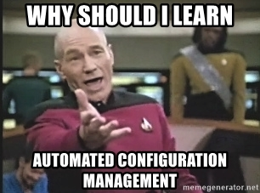
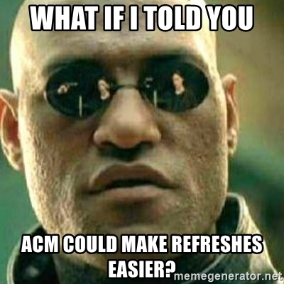
What Have I GOT myself into?

Slide 11
How do I get started?
Security Permissions needed for ACM
ACM Administrator
Permission Lists PTPT1000 and PTP48000
Introduction to ACM Utilities and Templates
Main Menu – PeopleTools – Automated Config Manager
Download delivered template for offline work. Recommendation is to test online before developing your own template. For the purposes of our presentation we will use the templates found below:
IB_TEMPLATE will fail for “Download Current Config” if App and Web Server are on separate servers. The the resulting template text file will show #IB not configured properly= in several sections.
PRCS_SCHEDULER_TEMPLATE
SEARCH_TEMPLATE

Slide 12
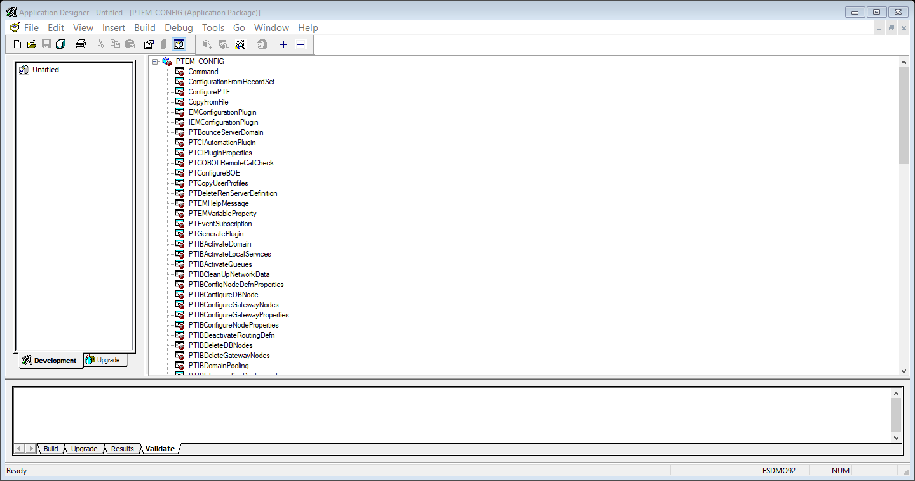
ACM in app Designer
All ACM Plugins can be found in the App Package PTEM_CONFIG. When drilling into the actual code you will notice that some are dark (active) and some are greyed out (Not ready for prime time)

Slide 13
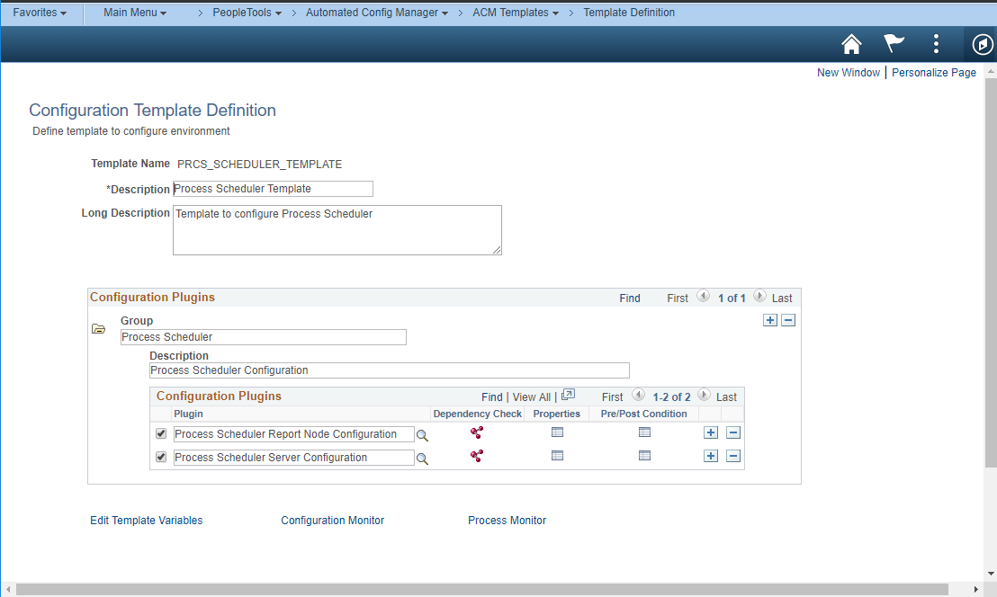
ACM ONLINE

Slide 14
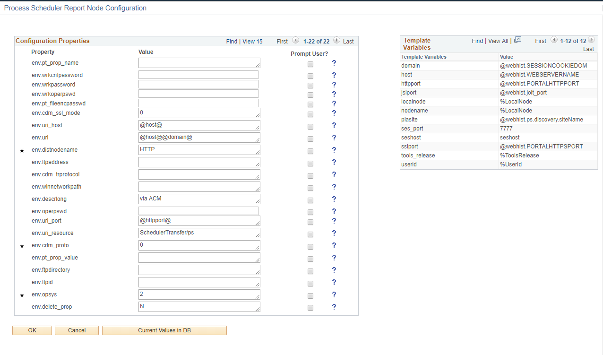
ACM ONLINE - continued
Values marked with * are required fields in the template

Slide 15

Working with the template files
FUN WITH THE FLAGS!!
configure=true
Set to true for configuring the system. Set to false for encrypting passwords
verify=true
In 8.55 this should be set to false as the verification will not work correctly
decrypt_password=true
Set for decrypting encrypted passwords.
encrypt_password=true
Set when encrypting sensitive data.

Slide 16
Working with the template files
# will comment out any line. If placed at the beginning of a plugin call it will keep the section from executing.
#plugin.IB Gateway Configuration.4=PTEM_CONFIG:PTIBConfigureGatewayProperties
Template variables are used as substitution variables in the plugin section.
template.domain declared at top will be @domain@ in the execution statement.
Template variables can also be used to have one template file for all test regions that have common elements.

Slide 17
COMMAND LINE
Running ACM from command line
PSRUNACM.BAT - PreBoot
Used for configuring IB, Report Node, and Search Server settings before starting any of the schedulers
No servers need to be running to use.
Locate in %PS_HOME%\Utilities folder.
$SERVER ORACLE $DATABASE $USER $PASS $TEMPLATE $OPTION
EXEC - run the template
IMP – import template
EXP – export template
PSAE.exe – PostBoot
PTEM_CONFIG is the app engine behind the plugings.
Can also be used for configuration settings.
Different from PSRUNACM.bat as it is used to Undeploy, Deploy, and Index Search Indexes. Will kick off jobs on Process Scheduler
Web, App servers need to be running.
Used to encrypt sensitive passwords when developing custom templates.

Slide 18
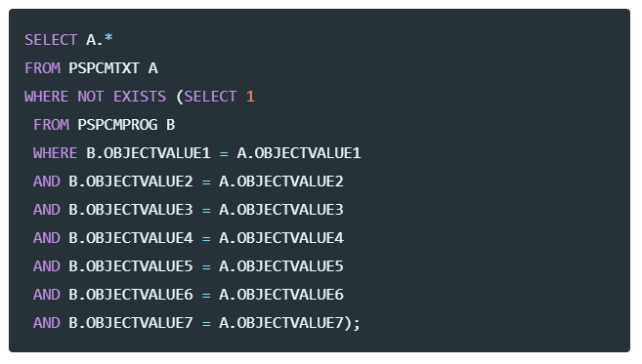
What about the hidden acm?
So…now you want to see the hidden (in progress) ACM code and possibly create your own custom leverage code!
Find Hidden ACM code! – YMMV. This works in 8.55 but only in certain levels of 8.56. See the link for more info. All of these are at my GITHUB site for the presentation - .

Slide 19
Working with the hidden code
Digging in a little bit…
method isInternalPlugin
/+ Returns Boolean +/
/+ Extends/implements PTEM_CONFIG:EMConfigurationPlugin.isInternalPlugin +/
Return True;
end-method;
Change “Return True;” to be “Return False;”. This will allow the plugin to be used in the Online ACM tools to help develop and troubleshoot. Again I recommend this method to troubleshoot and see where any issues may be. Once that is done we can add this to a plugin group and develop a template online! Yay!

Slide 20
Working with the hidden code
Digging in a little bit…
method isInternalPlugin
/+ Returns Boolean +/
/+ Extends/implements PTEM_CONFIG:EMConfigurationPlugin.isInternalPlugin +/
Return True;
end-method;
Change “Return True;” to be “Return False;”. This will allow the plugin to be used in the Online ACM tools to help develop and troubleshoot. Again I recommend this method to troubleshoot and see where any issues may be. Once that is done we can add this to a plugin group and develop a template online! Yay!

Slide 21
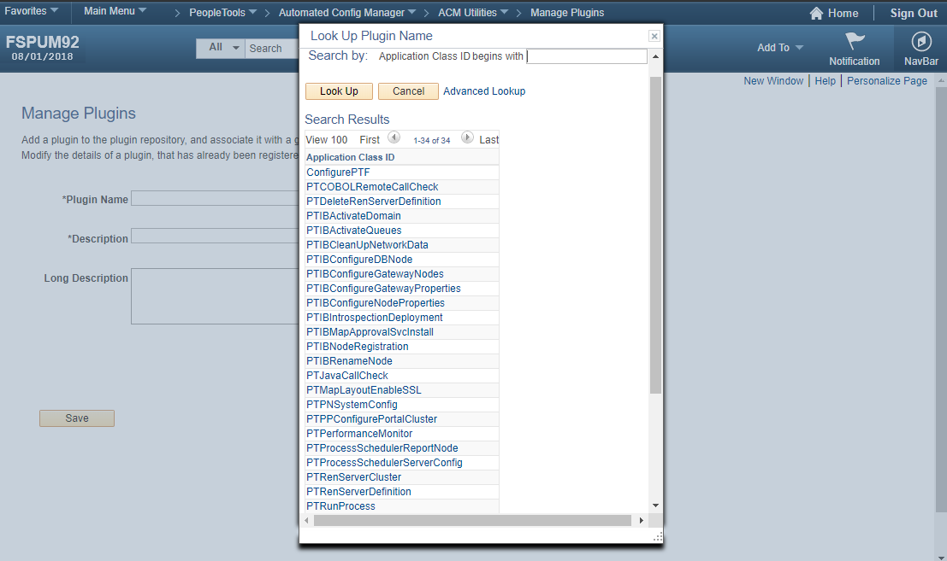
Working with the hidden code
Now our visible plugin shows up in the manage plugins page!

Slide 22
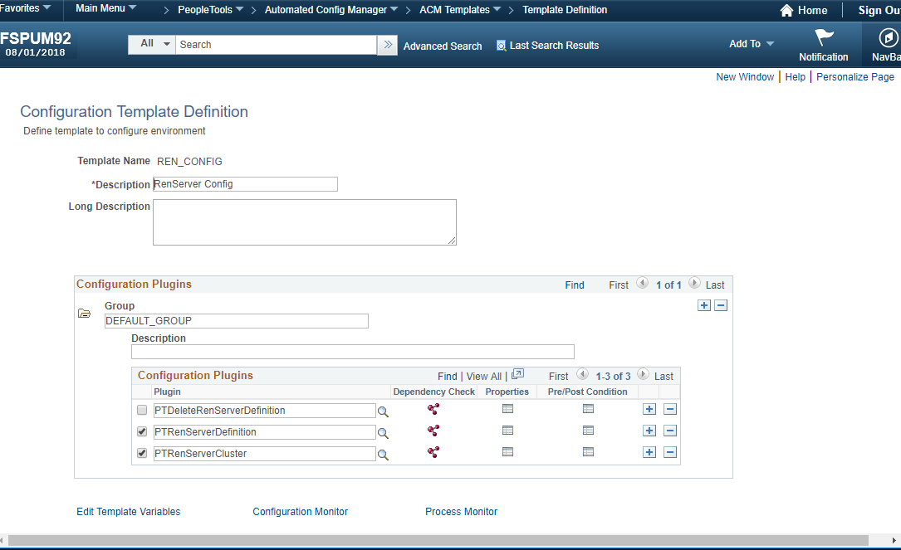
Working with the hidden code
The next step is to create a template and add the security for the new template to Permission List PTPT4800.

Slide 23
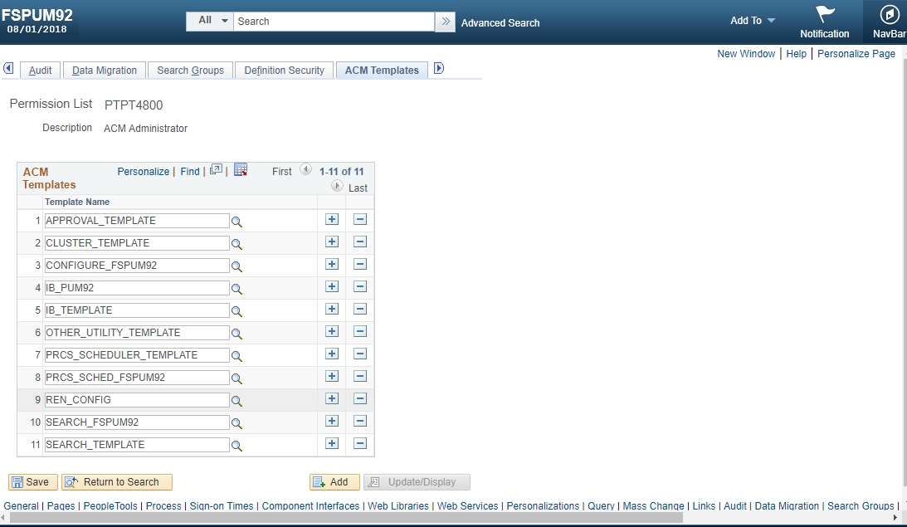
Working with the hidden code

Slide 24
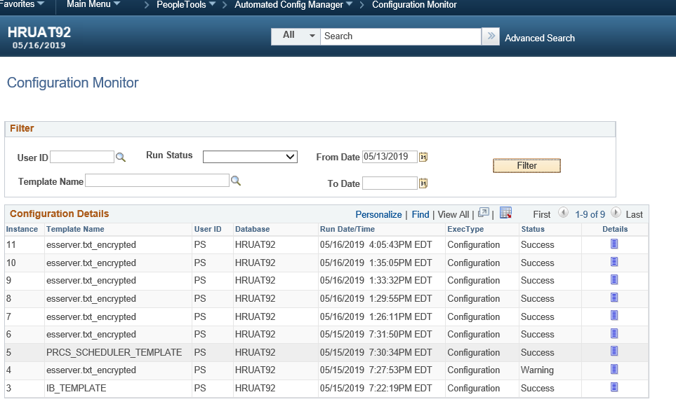
Verification and details

Slide 25
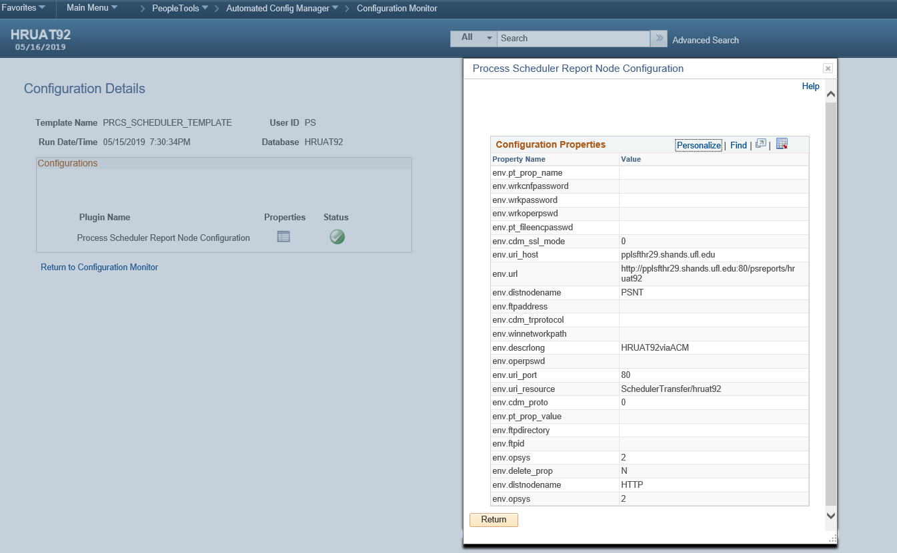
Verification and details

Slide 26
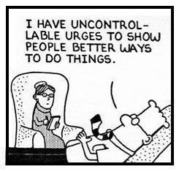

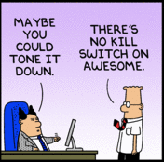
IT WORKS!
Verify all setups online. Report Node, Integration Broker, Search Instance.

Slide 27
FUTURE GOALS
Configure URLS
Configure IB node properties for non-local nodes
Expand ElasticSearch
Configure the Web Profile
Leverage ACM to scale down post refresh tasks.

Slide 28

Resources!
When we share ideas we all get better!
psadmin.io – slack message board is highly recommended.
PeopleSoft Mods – where I found the “Hidden ACM” trick ☺
Oracle ACM PeopleBooks
PeopleSoft Wiki
Github site

Slide 29
Concluding thoughts
ANY QUESTIONS?

Slide 30
presenters
Deepak Vij
David Miller
Associate Director – ERP Systems
UF Health
vijdee@Shands.ufl.edu
System Administrator
UF Health
miller.david@Shands.ufl.edu

Slide 31


THANK YOU!

